Slide 1
Project 3 secure Media Hosting Platform
Launch EC2 with restricted SSH access
Create private S3 bucket
Upload media files to S3
Serve media via EC2 web server

Slide 2
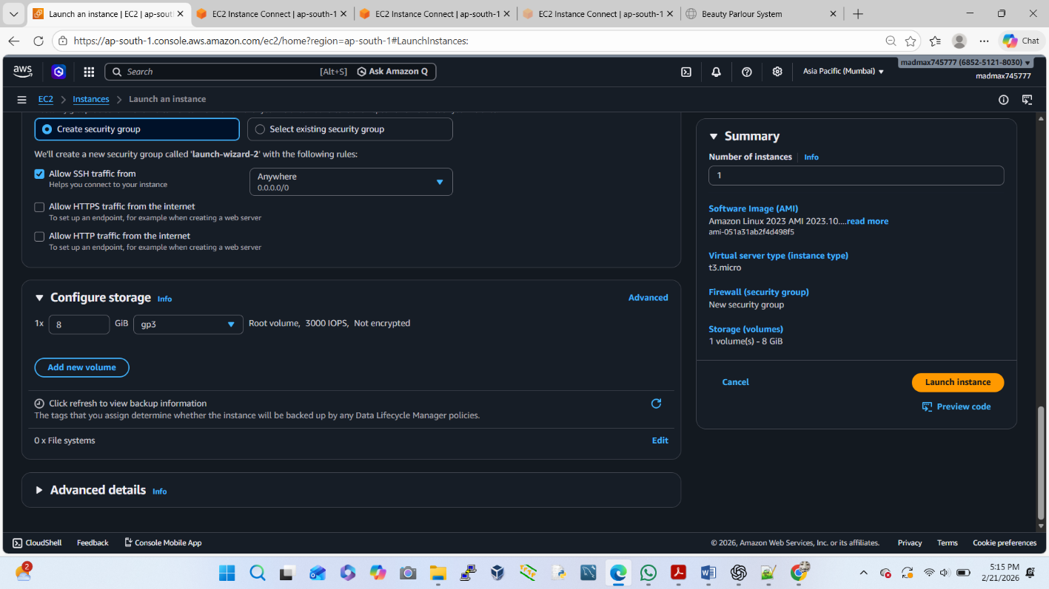
Launch EC2 with restricted SSH access
Login to Amazon Web Services Console
Go to EC2 → Launch Instance
Choose:
✔AMI: Amazon Linux 2
✔Instance type: t2.micro (Free Tier)
Key pair: create or select existing

Slide 3
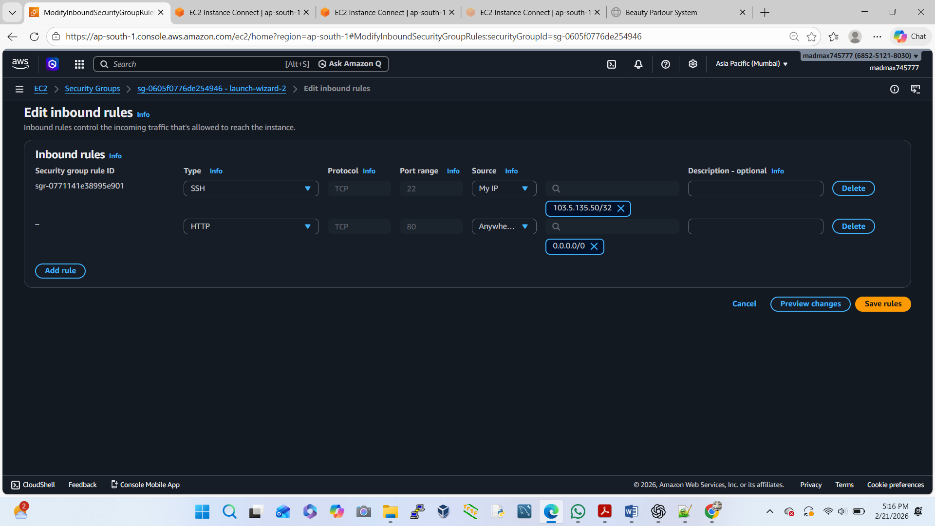
Configure Security Group
✔ SSH (22) → Source: My IP
✔ HTTP (80) → Source: Anywhere (0.0.0.0/0)

Slide 4
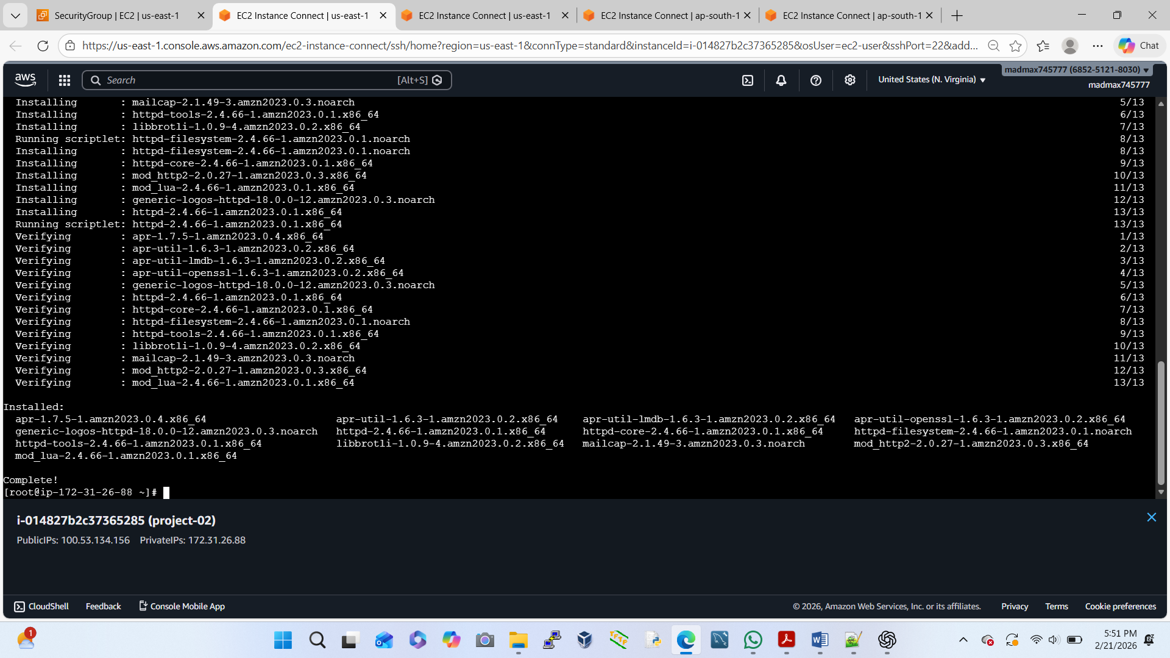
Install Web Server on EC2
Uses Some Command Here
sudo yum update -y
sudo yum install httpd -y
sudo systemctl start httpd
sudo systemctl enable httpd

Slide 5
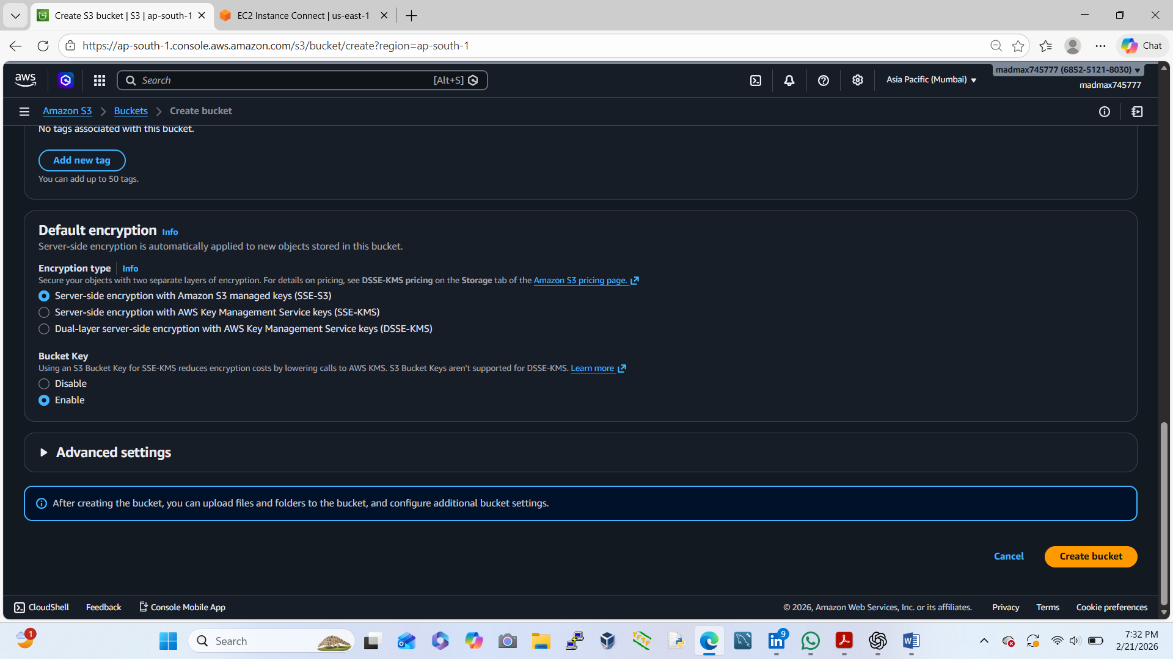
Create a Private S3 Bucket
Go to S3 → Create bucket
Bucket name: azad-projects786
Region: same as EC2
Block all public access → ON
Create bucket
✔ Our bucket is now completely private

Slide 6
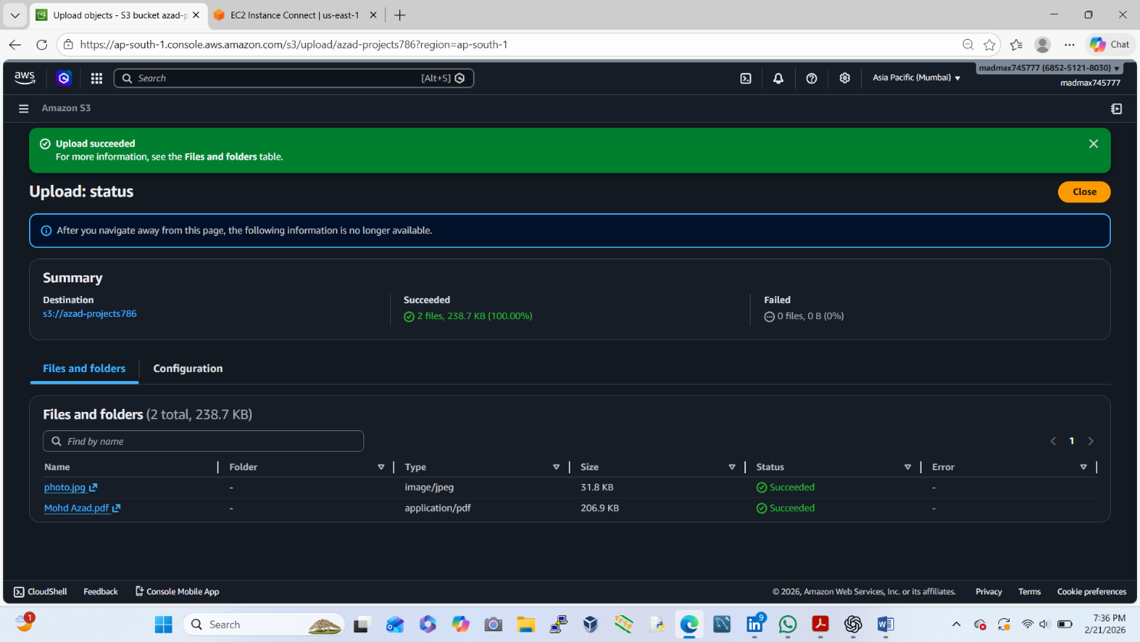
Upload Media Files to S3
Open bucket → Upload
Upload:
✔images (jpg/png)
✔Documents (pdf)

Slide 7
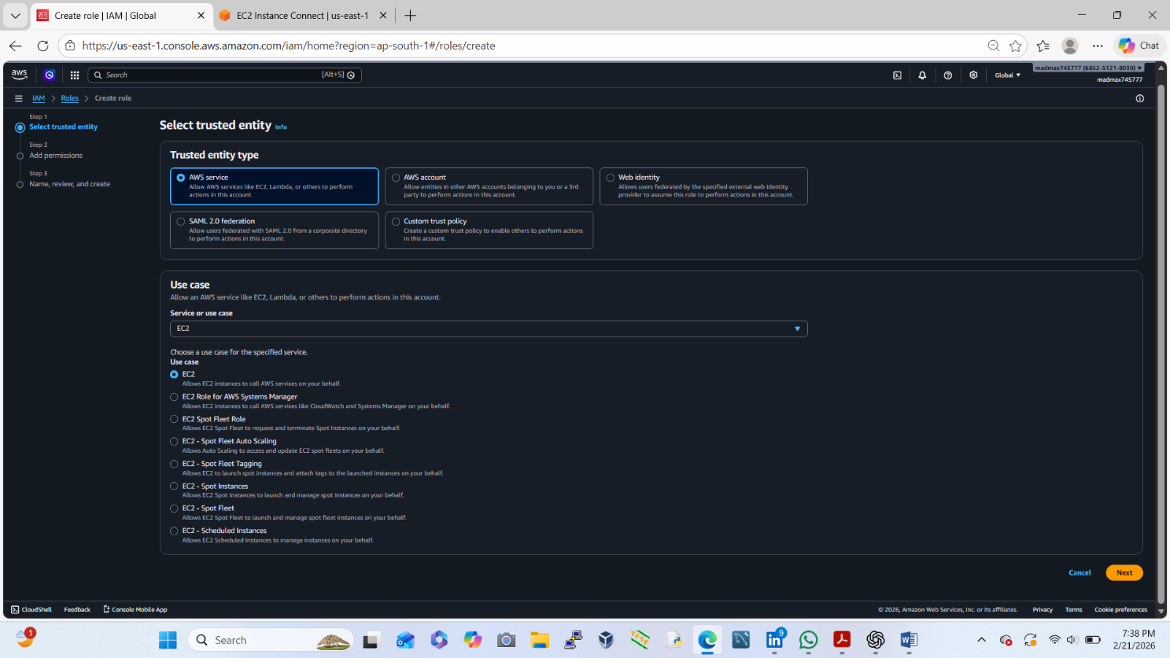
Create IAM Role for Secure S3 Access
Go to IAM → Roles → Create role
Trusted entity: EC2
Attach policy:

Slide 8
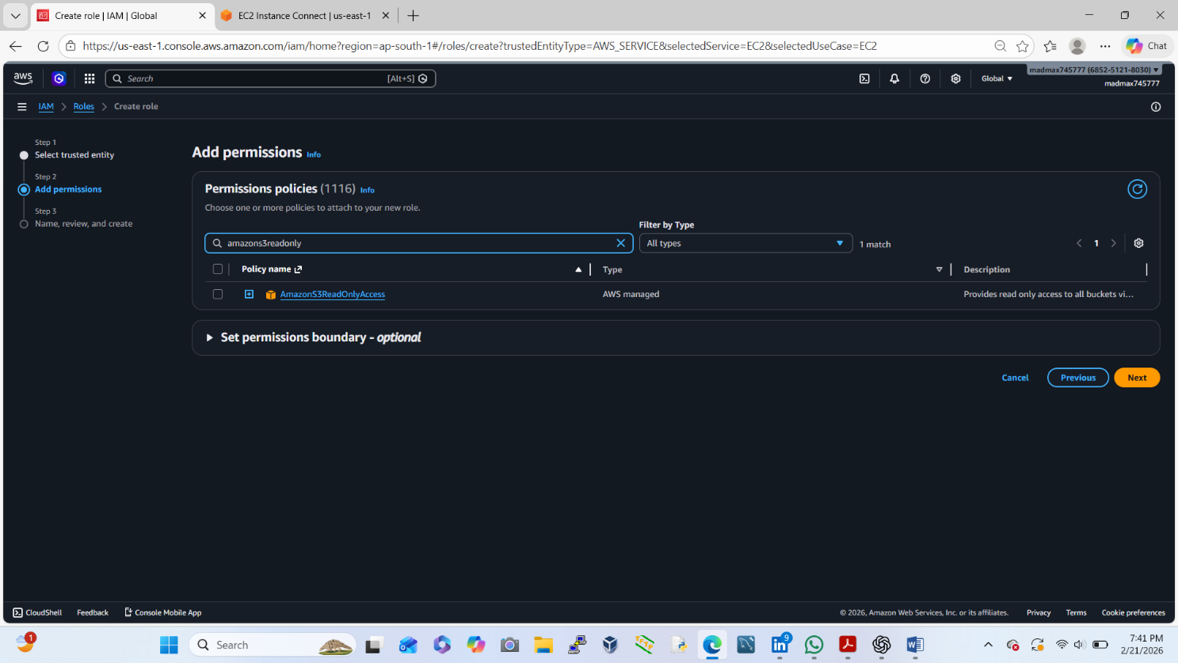
Add Permission
✔ AmazonS3ReadOnlyAccess
Role name: web-photo

Slide 9
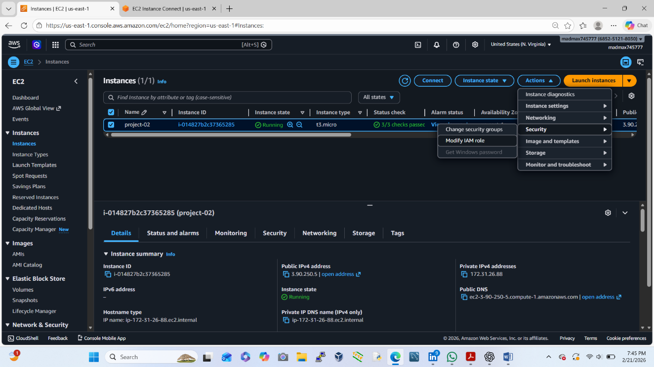
Go to EC2 Instance → project-02
Attach role to EC2:
✔ EC2 → Actions → Security → Modify IAM Role
EC2 can now access S3 without access keys

Slide 10
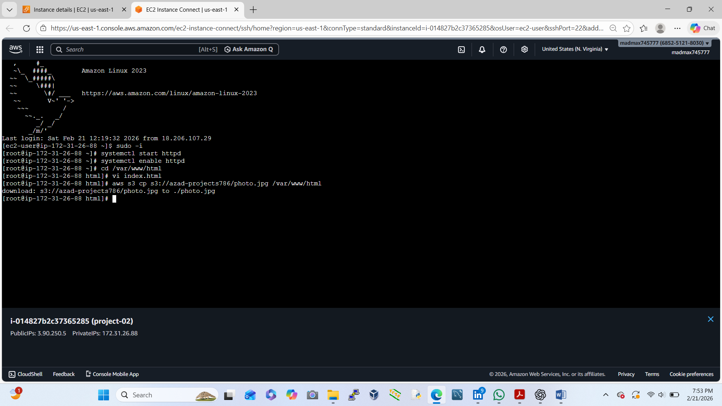
Serve S3 Media via EC2 Web Server
Install AWS CLI: $ sudo yum install aws-cli –y
Copy media from S3 to web directory:
$ aws s3 cp s3://azad-projects786/photo.jpg /var/www/html
Set permissions:
$ sudo chmod -R 755 /var/www/html

Slide 11
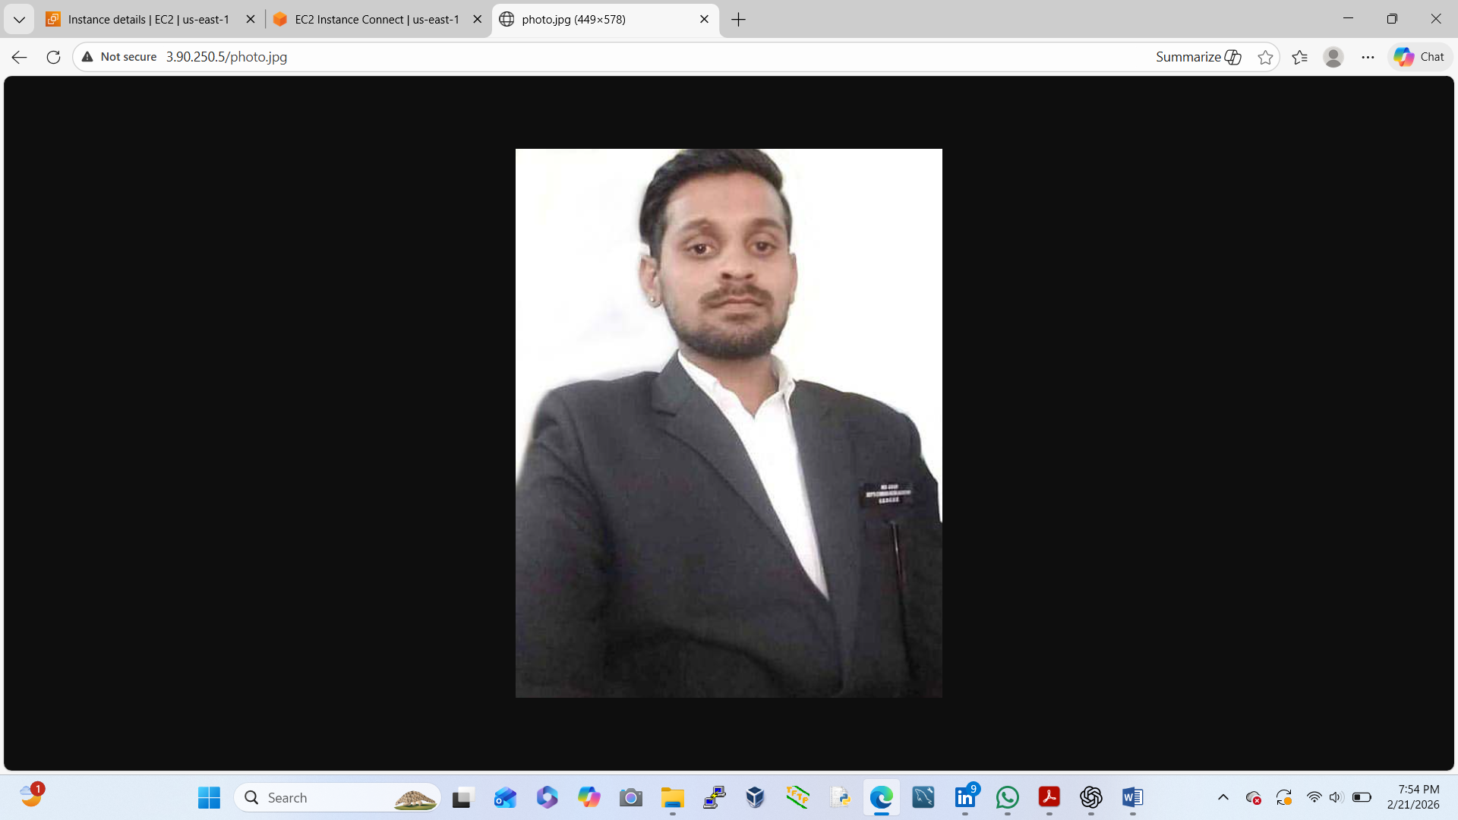
Access Media via Browser
Check Photo & Pdf file:
Open browser:
We take New-EC2-Public-IP
http://3.90.250.5/photo.jpg
http://3.90.250.5/Mohd Azad.pdf

